Slide 1
Crop Guidance
and
Farmers Friend

Slide 2
ORGANIZATION NAME : CDK Global
PROBLEM CODE : RA28
PROBELM STATEMENT : Crop Guidance and Farmers Friend
TEAM NAME : TEAM INCOGNITO
TEAM LEADER NAME : SHARANG RAMANA G
COLLEGE CODE : 2718
CATEGORY : Software
DOMAIN BUCKET : Agriculture and Rural Development

Slide 3
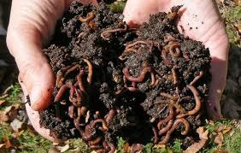
Problem Title
Helping the farmers in terms of Crop suggestion, precautions based on the met department forecast of rain fall / weather, potential pest attacks , weather warnings

Slide 4
Problem in detail
System that provides details to farmers on weather patterns that could impact the crop , possible pest attacks , weather warnings
Steps for producing high yield that are specific for a farmer based on the local, regional terrain , weather scenario , rather than generic guidance
Helping the Farmer to be well prepared if there is a pest, insect attack
Better Farmer Financial Inclusion for planning out loans , interest and managing his costs

Slide 5
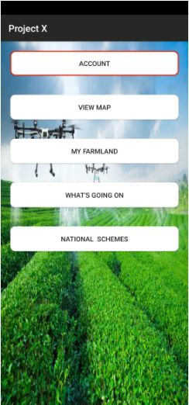

Slide 6
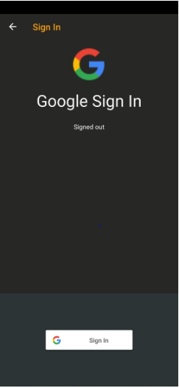
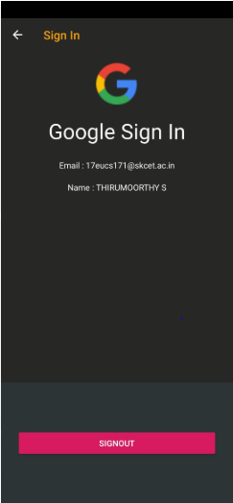

Slide 7
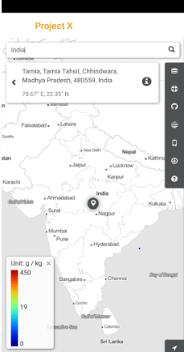
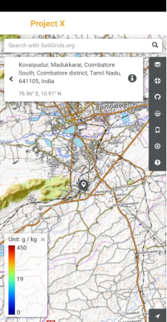

Slide 8
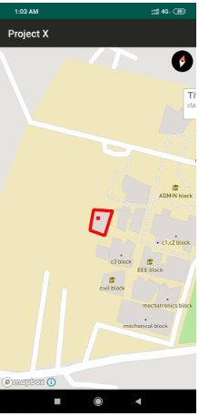
CUSTOM BOUNDARY

Slide 9
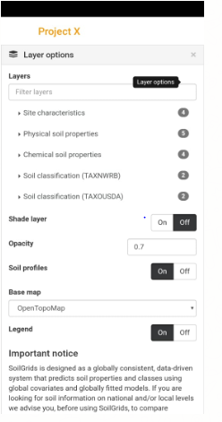
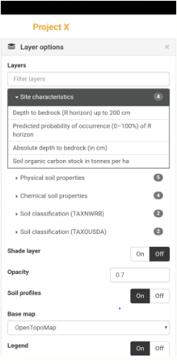

Slide 10
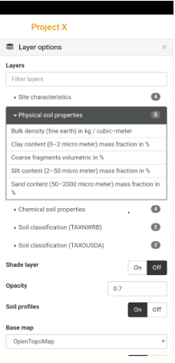
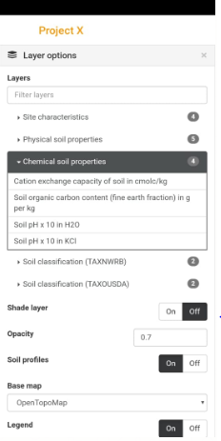

Slide 11
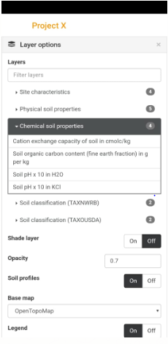
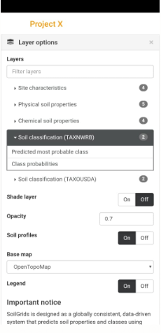

Slide 12
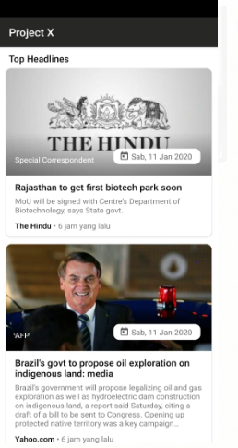
NEWS SECTION

Slide 13
Benefits of Solution
Famers, Pesticide firms, Government agencies helping farmers, Agriculture loan banks
How does it help the nation
Better crop produce and farmers have better income
High Yield and prescriptive guidance

Slide 14
Technology
HTML5
CSS3
Java Script
Django
Bootstrap
Sq3 Lite
Postgres
Android Studio
Map box Studio
Arc GIS
OSM files
Firebase
Tensor flow

Slide 15
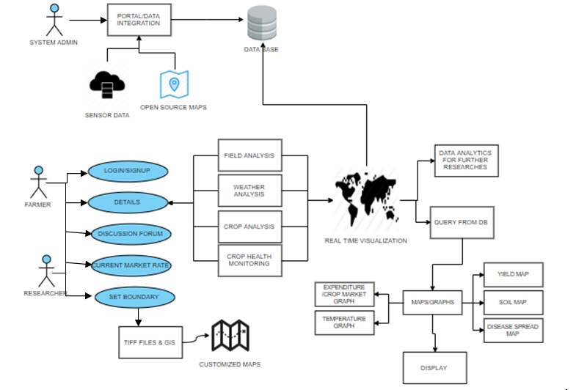

Slide 16

THANK YOU

